Slide 1
Feature Extraction From
Labeled Blobs
Tolledo, Charmaine S.

Slide 2
OVERVIEW OF THE ACTIVITY
Image feature extraction entails the identification and extraction of significant visual attributes, also known as features, from images. This is done with the aim of minimizing the quantity of data required to describe the image, while retaining its crucial details. [1]
In this activity, we had the opportunity to go beyond basic visual information and explore more advanced image processing techniques. Last time, we used ImageJ, but this time, we focused on feature extraction from labeled blobs, which involves coding and implementation. By employing these techniques, let’s aim to extract important features and patterns from the image and uncover valuable insights from our visual data!

Slide 3
OBJECTIVES
Segment images cleanly using thresholding and morphological operations
Automatically get features using Region props
Use statistical analysis to the extracted features.

Slide 4
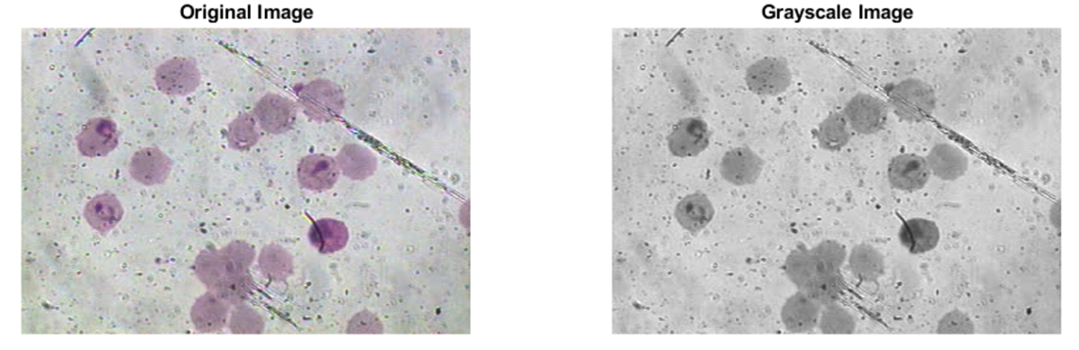
ORIGINAL IMAGES/OBJECTS USED
Here, we’ll apply morphological operations on biological sample, specifically to images of the malaria sample. First, we converted the original image to grayscale. This is to enhance the visibility of important features and structures within the biological sample.

Slide 5
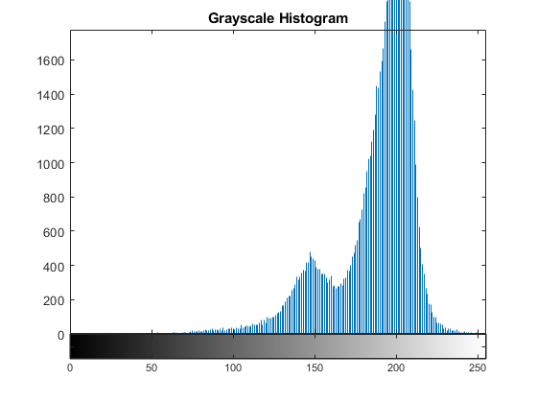
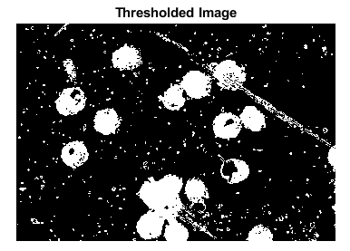
SEGMENT IMAGE CLEANLY USING THRESHOLDING
After converting the image to grayscale and analyzing its intensity distribution through a grayscale histogram (as seen in figure on the left), the next step was we applied a thresholding technique to create a binary image. In this case, a threshold value range was defined, specifically considering intensity values that are greater than 100 and less than 164. This is to segment and isolate regions of interest within the grayscale image based on their intensity values.

Slide 6
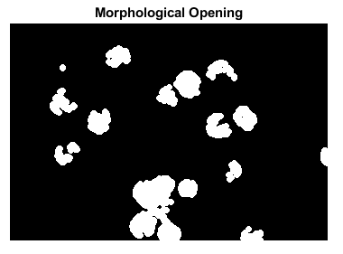
SEGMENT IMAGE CLEANLY USING MORPHOLOGICAL OPENING
Here, we applied the concept of morphological opening in which involves performing an erosion followed by a dilation operation and a disk-shaped structuring element with a radius of 2 (This choice was guided by the principle of using a structuring element that aligns with the desired pixel shape for removal.) And as we can see, the morphological opening smoothed out irregularities and fine details present in the image and successfully eliminated extraneous pixel spots. It literally provided a cleaner background and really emphasized the more significant regions of interest.

Slide 7
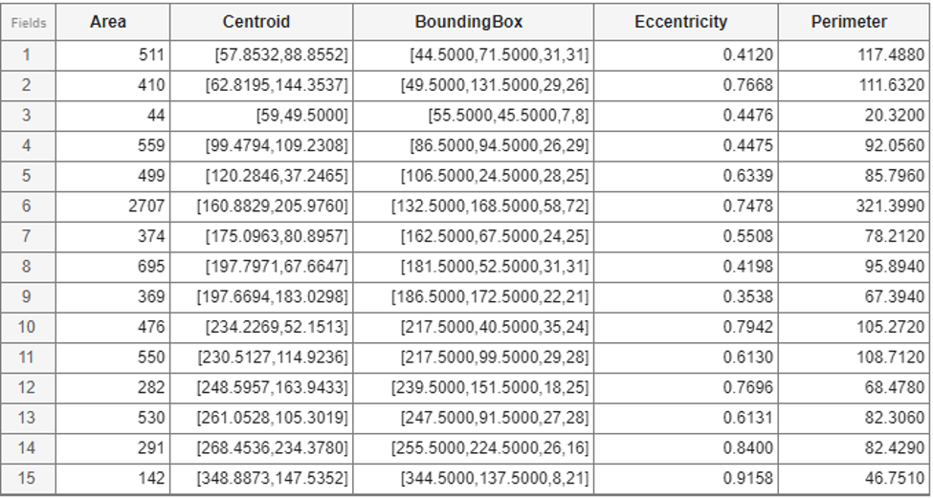
FEATURE USING REGIONPROPS
Here, after we cleaned the image using thresholding and morphological opening, we used the ‘regionprops’ function of MATLAB to extract features from the processed image. And as we can see from the figure on the left, we obtained properties such as area, eccentricity, perimeter, centroid coordinates, and bounding box dimensions for each region, which are the quantitative information that enables us to analyze and understand the objects present in the image.

Slide 8
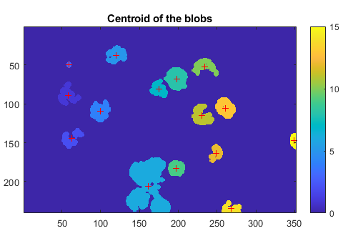
CENTROID OF THE BLOBS
The resulting image shown above displays the original image with the centroids marked as red crosses ('+'). Each red cross represents the centroid position of a labeled region. The centroid positions were obtained by computing the Centroid property using the regionprops function.

Slide 9
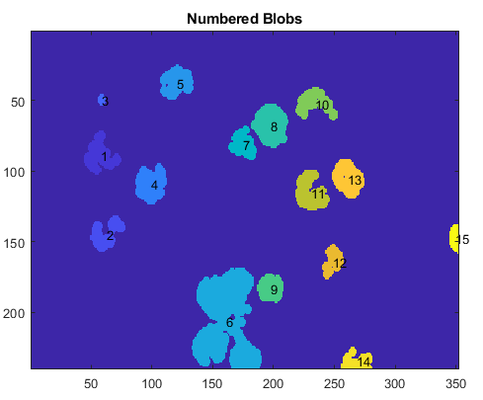
LABEL NUMBERS ON CENTROID BLOBS
Now, we see here the resulting image displays the original image with each blob numbered according to its centroid positions. This allows for a clear identification and reference of individual objects within the image. This labeling system makes it easier to understand the image's content in more depth, which helps with further analysis. The numbered blobs are used as points of reference for spatial relationships and numeric measures. This makes it easier to assess a the presence and location of specific objects in the image.

Slide 10
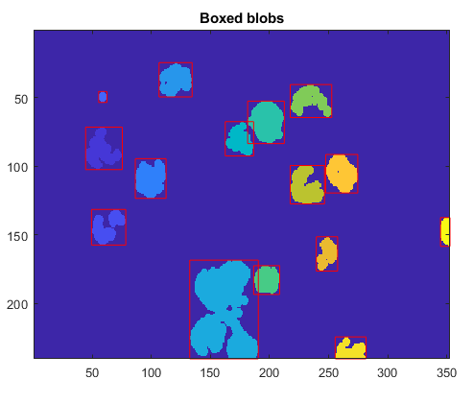
BOUNDING BOXES AROUND EACH BLOB
The resulting image above shows the original image with individual bounding boxes encompassing the blobs. The red boxes outline the edges of the blobs, making it easy to find and examine the objects. These boxes make it easier to do things like recognize objects, divide them up, and look at how they fit together in space.

Slide 11
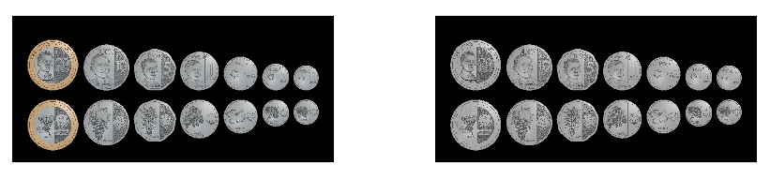
ORIGINAL IMAGES/OBJECTS USED
https://www.manilatimes.net/manilatimes/uploads/images/2022/01/27/43821.jpg
We’ll also try to feature extract our different Philippine coins using labeled blobs to get significant quantitative info. But before doing so, like the first image, we also convert this into its grayscale image, as shown above.

Slide 12
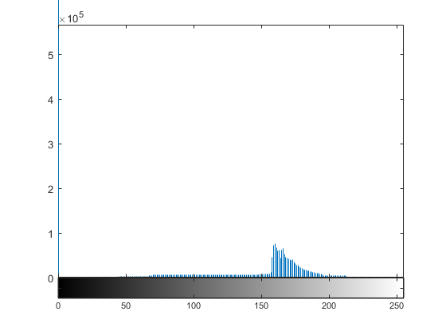
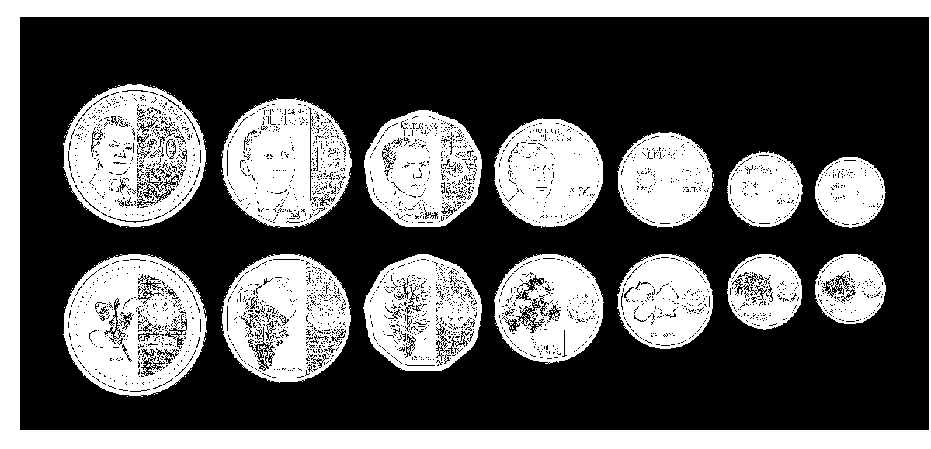
After converting the image to grayscale and analyzing its intensity distribution through a grayscale histogram (as seen in figure on the left), we also applied a thresholding technique to create a binary image and to segment the image clearly.

Slide 13
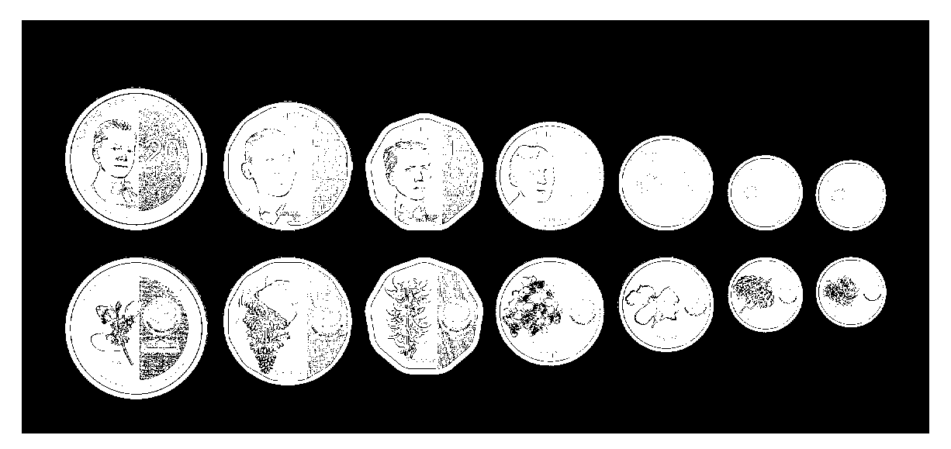
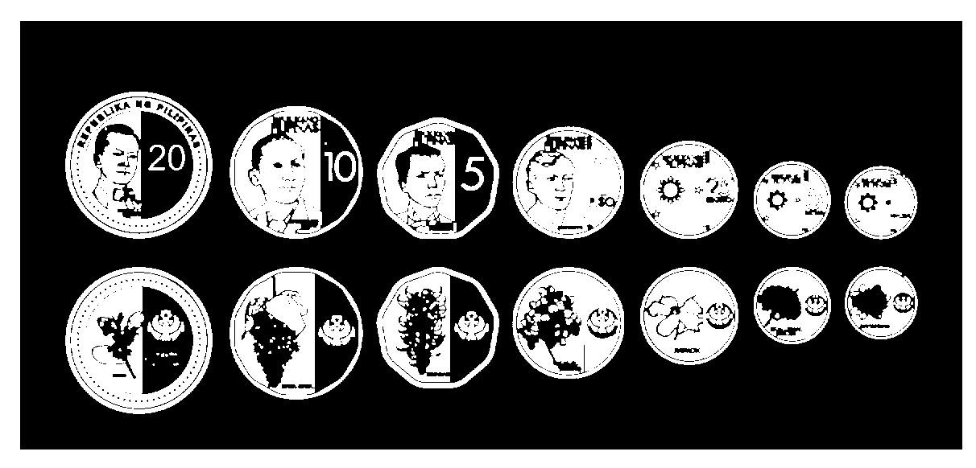

MORPHOLOGICAL OPERATIONS
Now, to further segment the image clearly, we used morphological operations. For the first image (upper left), we applied the "majority" morphological operation to the thresholded image using the "bwmorph" function in MATLAB to get rid of the “small dusts”. The second image (upper right), we applied the concept of morphological opening in which involves performing an erosion followed by a dilation operation and a disk-shaped structuring element with a radius of 5. Finally, the third image (lower middle), we applied the concept of morphological closing which combines the dilation followed by the erosion process. As we can see, the final result was a very clean image after applying thresholding and multiple morphological operations.

Slide 14
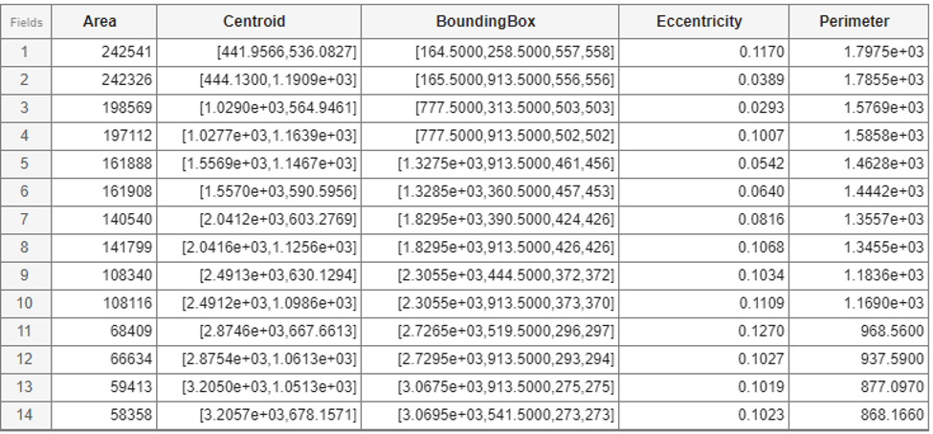
This table provides a concise overview of the extracted information. It provides the numerical values for each designated feature from the analysis. Using the ‘regionprops’ function in MATLAB, we were able to obtain the area, centroid, bounding box, eccentricity, and perimeter of the different PH coins, as seen in the figure on the left.

Slide 15
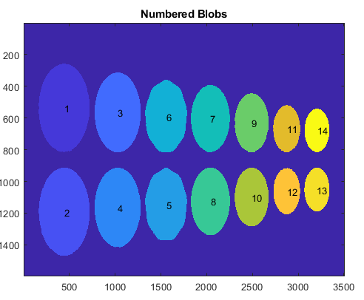
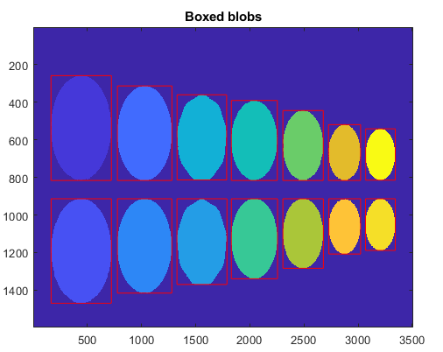
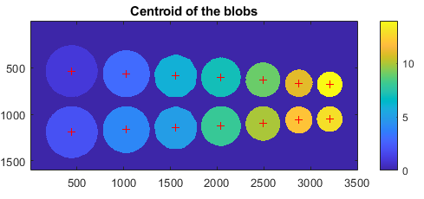
In the context of analyzing different PH coins, several feature extraction techniques are employed to gain insights about the coins. By placing centroids in the middle of each coin (as seen in the first image), we establish a visual reference for their position within the image. In addition, labeling the centroids with corresponding numbers (second image) facilitates precise identification and coin tracking. In addition, drawing bounding boxes around each coin (third image) provides a visual representation of their size, shape, and orientation.

Slide 16
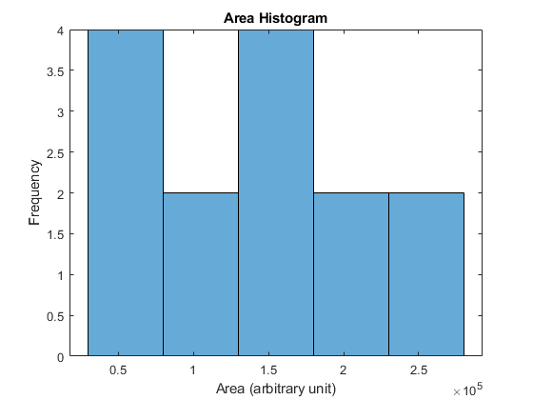
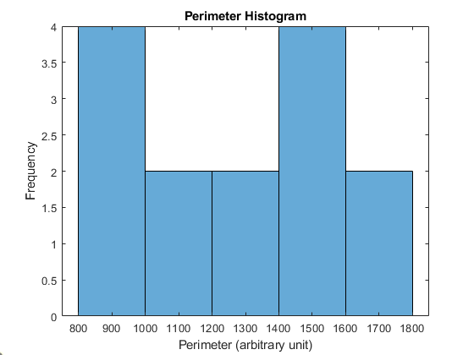
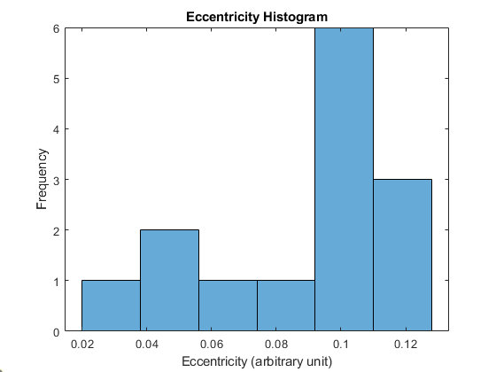
STATISTICAL ANALYSIS TO THE EXTRACTED FEATURES
Lastly, to statistically analyze the extracted features, we generated histograms of the extracted features (area, perimeter, and eccentricity). On the area histrogram, we can observe the range of coin sizes and the distribution of coins within different size categories. Meanwhile, the perimeter histogram provides information about the distribution of coin boundary lengths, which can be indicative of the complexity or irregularity of the coin shapes. The eccentricity histogram, on the other hand, reveals the distribution of coin shapes, ranging from more circular to more elongated or irregular.

Slide 17
REFLECTION
This task was made much simpler by the fact that I had already coded the first image lat activity. In the last task, I used thresholding and morphological opening to successfully segment the malaria picture; now all I have to do is copy and paste that code into this one. It was also simple for me to implement because ma'am Jing provides the code for feature extraction. In general, I enjoyed the activity, and I find it encouraging that we can accomplish by programming whatever that software (like imageJ) can. So, I’ll give myself a 10/10

Slide 18
REFERENCES
[1]https://www.mygreatlearning.com/blog/feature-extraction-in-imageprocessing/#:~:text=Feature%20extraction%20is%20a%20part,a%20large%20number%20of%20variables.
Lab Manual

Slide 19
End

